Slide 1


Innovative Methodologies for Teaching and Learning
Being an Educator in 2026 and beyond

Slide 2


A little bit about you…
Name and where you are from…
What do you bring today?
(One phrase, please…)

Slide 3

Let’s have a date!
Draw a blank clock in your notebook.
Now find a date for every hour on the clock.
Try not to repeat partners (but if necessary you can)
Now sit down and wait for instruction.

Slide 4
Let’s have a date!
Are you free at 1 o’clock?
Can we meet at 1 o’ clock?
When are you free?
Do you have any hour free?

Slide 5
Let’s have a date!
Are you free at 1 o’clock?
Can we meet at 1 o’ clock?
When are you free?
Do you have any hour free?

Slide 6
Let’s have a date!!
It’s 1 o´clock.
How many years have you been teaching?

Slide 7
Let’s have a date!!
It’s 2 o´clock.
What made you participate in an Erasmus+ Project?

Slide 8
Let’s have a date!!
It’s 3 o´clock.
What subject do you teach and what level?

Slide 9
Let’s have a date!!
It’s 4 o´clock.
How would you describe your teaching method?

Slide 10
Let’s have a date!!
It’s 5 o´clock.
Do your students use digital devices in the classroom?

Slide 11
Let’s have a date!!
It’s 6 o´clock.
Does your school encourage you to use any particular methodology?

Slide 12
Let’s have a date!!
It’s 7 o´clock.
How do you feel about exams?

Slide 13
Let’s have a date!!
It’s 8 o´clock.
What kind of learner are you / were you when you were a student?

Slide 14
Let’s have a date!!
It’s 9 o´clock.
What is the one big change you would like to make in your teaching?

Slide 15
Let’s have a date!!
It’s 10 o´clock.
Name some methodologies or approaches to teaching.

Slide 16
Let’s have a date!!
It’s 11 o´clock.
What are your students’ biggest challenges?

Slide 17
Let’s have a date!!
It’s 12 o´clock.
What are your biggest challenges as a teacher?

Slide 18
Freewrite
What do you want to get out of this week?
What do you hope to take back to your classroom and students?

Slide 19
Innovative Methodologies for Teaching and Learning
21st Century Skills

Slide 20

21st Century Learning Skills are grouped as follows:
Learning Skills | Literacy Skills | Life Skills
Can you give some examples?
Who is responsible for teaching students these skills?
Think-Pair-Share

Slide 21
The four Cs of Learning Skills
These are thought to make the biggest impact in terms of setting your students apart when applying for and starting their careers
Critical Thinking
Collaboration
Creativity
Communication

Slide 22
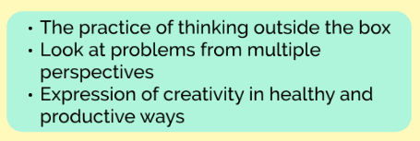
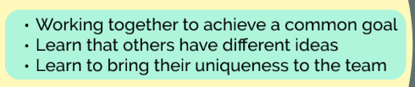
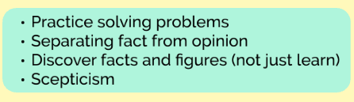
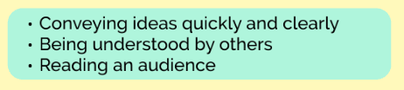
Critical thinking, Collaboration, Creativity, Communication

Slide 23



The four Cs
Which skills have we already practised today?
Critical Thinking
Collaboration
Creativity
Communication

Slide 24
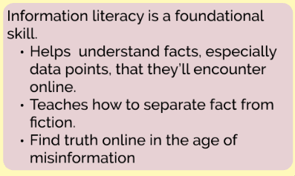
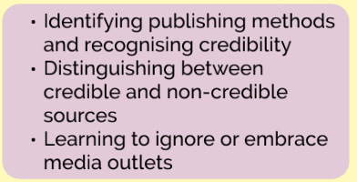
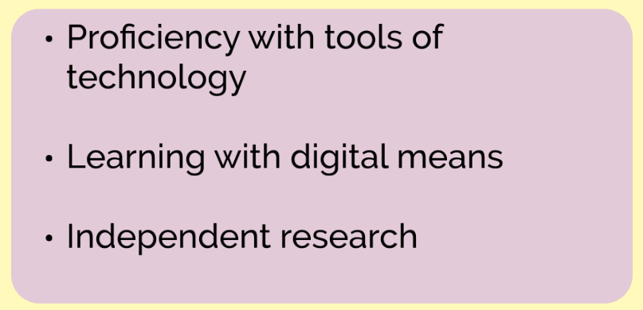
Literacy skills
Information
Media
Technology

Slide 25
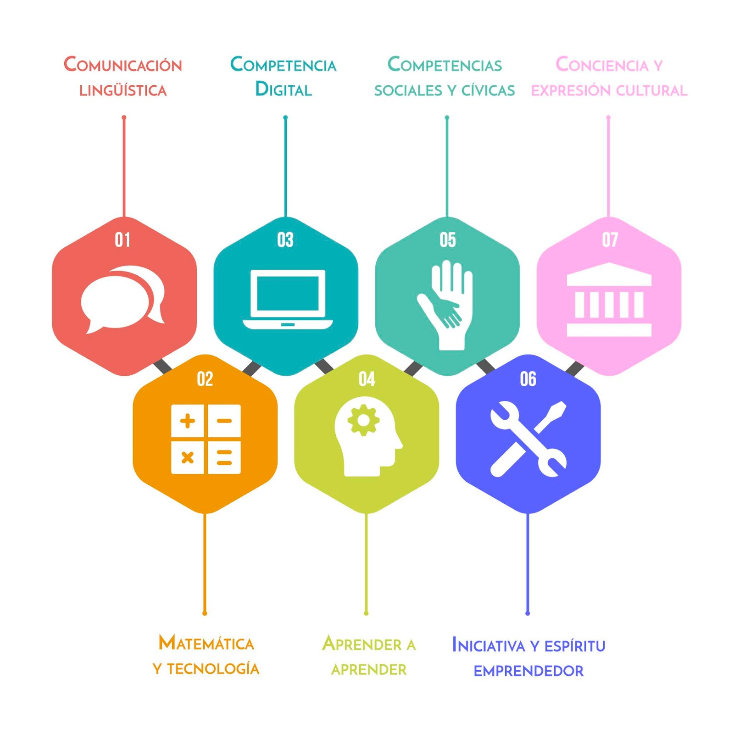
Technology and digital literacy
In many countries this is now a required part of the curriculum
Spain, LOMLOE, 2020

Slide 26
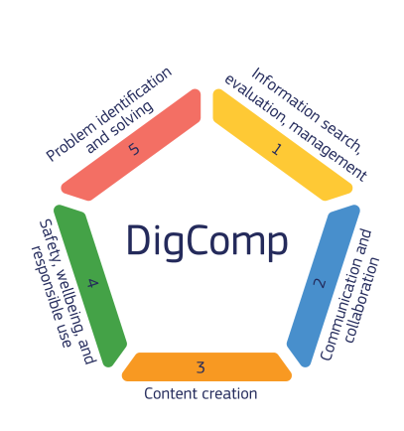
Many European countries include digital competence as a required part of the curriculum and utilize the European Digital Competence Framework
Is digital competence a part of the required curriculum in your country? How is it integrated into teaching in your schools?

Slide 27
Life skills
What do these mean and how do young people practise and show these in a classroom?
Pass the Page
Flexibility
Leadership
Initiative
Productivity
Social skills

Slide 28
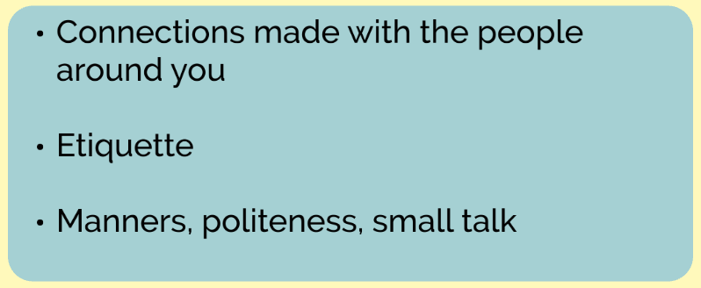
Flexibility

Slide 29
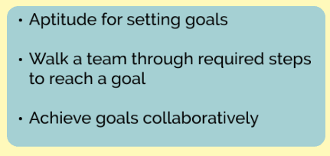
Leadership

Slide 30
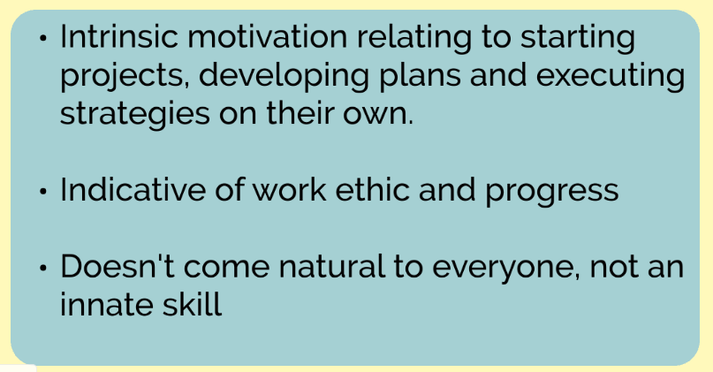
Initiative

Slide 31
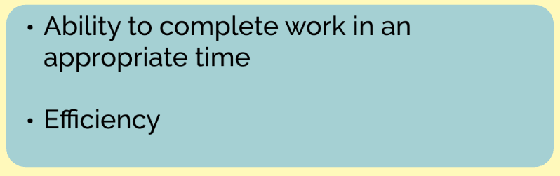
Productivity

Slide 32
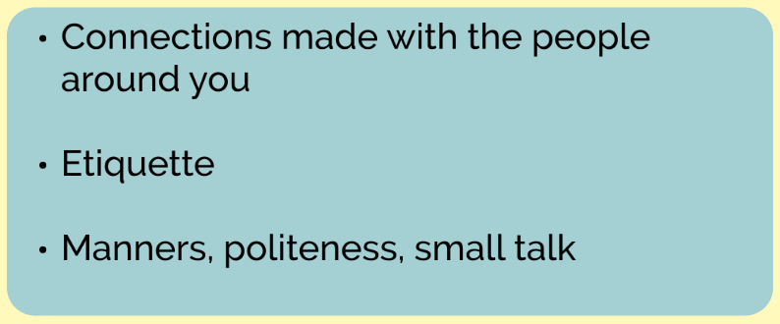
Social skills

Slide 33
More than just theory …

Slide 34
STATION ROTATION
In this activity, you will move through a series of stations designed to help you think deeply, share ideas, and make thoughtful decisions. Each station focuses on a different way of exploring one of the 21st century skills, and you’ll have time to go through all the stations.
Work in groups of 4.
Spend 10–15 minutes at each station.
Follow the task card at each station carefully.
Use group discussion to complete the activity—everyone should participate!
When time is up, rotate to the next station as directed.
At the end, we’ll come together to reflect on what you learned at each station.

Slide 35


Slide 36



Gracias : ) Thank you!
www.englishmatters.org
english@englishmatters.eu
www.facebook.com/englishmatters.org
@english.matters
@EnglishMattersE

